Slide 1










Subtopic N2.4 - Use Formal Methods for Addition of Integers
LEARNING OUTCOME: To add integers formally using the column method
Objectives:
Keywords:
Integer
Addition
Sum
Exchange
Place value
1. To add integers using column addition
2. To accurately use exchanges in column addition
3. To add integers up to the thousands column
Introduction – Read and annotate:
Column addition is a written method used to add numbers by lining them up according to place value
(ones, tens, hundreds, etc.). It helps you add each column of digits step by step, starting from the
right, and exchange any value that goes over ten into the next column. It is important to line up the
digits correctly by place value to make sure you get the correct answer.
Definition
Characteristics
A whole number.
Can be positive or negative.
No decimal or fractional part when simplified.
Integer
Examples
-42
1.1
-8.5
Non - Examples
11
-11
27.5
0.42
Placing and adding two-digit integers using column method, no exchanging
Example 1 - I do…
Example 2 - We do…
Example 3 - You do…
Steps | Calculate 15 + 30 | Calculate 30 + 22 | Calculate 22 + 50
1. Line up both numbers in the correct columns
2. Add each column starting with the ones column
 | T | O
+
 | T | O
+
 | T | O
+
45
52
72
Independent Practice
1. Place the integers in the place value grids and them using column method
a) Calculate 14 + 13
b) Calculate 15 + 12
c) Calculate 13 + 15
d) Calculate 21 + 13
 | T | O
+
 | T | O
+
 | T | O
+
 | T | O
+
27
27
28
34

Slide 2
e) Calculate 14 + 23
f) Calculate 15 + 32
g) Calculate 13 + 45
h) Calculate 17 + 32
 | T | O
+
 | T | O
+
 | T | O
+
 | T | O
+
37
47
58
49
i) Calculate 13 + 21
f) Calculate 15 + 30
g) Calculate 13 + 45
h) Calculate 57 + 22
 | T | O
+
 | T | O
+
 | T | O
+
 | T | O
+
34
45
58
79
Setting out and adding two-digit integers using column method, no exchanging
Example 4 - I do…
Example 5 - We do…
Example 6 - You do…
Steps | Calculate 45 + 32 | Calculate 13 + 75 | Calculate 54 + 24
1. Line up both numbers in the correct columns
2. Add each column starting with the ones column
77
88
78
Independent Practice
2. Add the following integers using column method
a) 13 + 51 b) 15 + 31 c) 51 + 13 d) 17 + 21 e) 21 + 17
44
46
64
38
38
f) 13 + 24 g) 23 + 32 h) 23 + 56 i) 75 + 23 j) 19 + 20
37
55
79
98
39

Slide 3
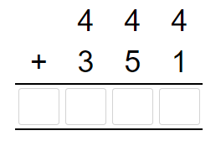
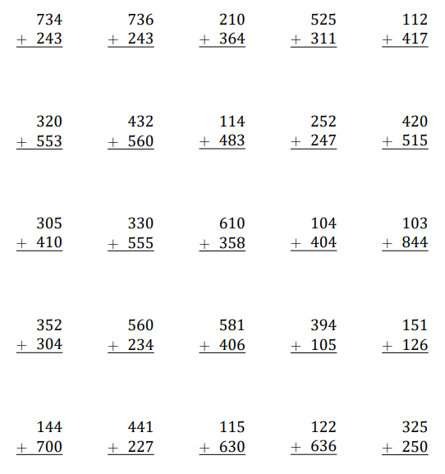
k) 33 + 24 l) 33 + 32 m) 13 + 26 n) 75 + 12 o) 18 + 71
57
65
39
87
89
p) Sally is calculating 438 + 100. Can you explain the mistake she has made?
4 3 8
+ 1 0 0
4 4 8 0
The columns are not lined up correctly. The answer is 538
Adding with two and three-digit integers using column method, no exchanging
Example 7 - I do…
Example 8 - We do…
Example 9 - You do…
Steps | Calculate 444 + 351 | Calculate 351 + 30 | Calculate 447 + 532
1. Add each column starting with the ones column
3 5 1
4 4 7
+ 3 0
+ 5 3 2
795
381
979
Independent Practice
3. Add the following integers using column method
977
779
574
836
429
873
992
197
499
935
715
385
968
508
947
656
594
987
199
277

Slide 4
Placing and adding with two and three-digit integers using column method, no exchanging
Example 10 - I do…
Example 11 - We do…
Example 12 - You do…
Steps | Calculate 404 + 215 | Calculate 234 + 31 | Calculate 861 + 125
1.. Line up both numbers in the correct columns
2. Add each column starting with the ones column
 | H | T | O
+
 | H | T | O
+
 | H | T | O
+
619
265
986
Independent Practice
4. Place the integers in the place value grids and them using column method
a) Calculate 102 + 223
b) Calculate 142 + 137
c) Calculate 361 + 134
d) Calculate 417 + 121
 | H | T | O
+
 | H | T | O
+
 | H | T | O
+
 | H | T | O
+
325
279
495
538
e) Calculate 126 + 213
f) Calculate 121 + 28
g) Calculate 28 + 271
h) Calculate 271 + 18
 | H | T | O
+
 | H | T | O
+
 | H | T | O
+
 | H | T | O
+
339
149
299
289
Setting up and adding two and three-digit integers using column method, no exchanging
Example 13 - I do…
Example 14 - We do…
Example 15 - You do…
Steps | Calculate 522 + 307 | Calculate 36 + 721 | Calculate 542 + 315
1. Line up both numbers in the correct columns
2. Add each column starting with the ones column
829
757
857

Slide 5
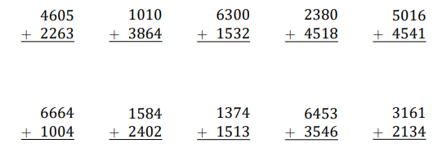
Independent Practice
5. Add the following integers using column method
a) 130 + 150 b) 150 + 130 c) 250 + 132 d) 170 + 24 e) 224 + 342
280
280
382
194
566
f) 136 + 13 g) 239 + 140 h) 23 + 156 i) 454 + 432 j) 851 + 124
149
379
179
886
975
Adding up to four-digit integers using column method, no exchanging
Example 16 - I do…
Example 17 - We do…
Example 18 - You do…
Steps | Calculate 1320 + 2245 | Calculate 3512 + 307 | Calculate 7478 + 1321
1. Add each column starting with the ones column
1 3 2 0
3 5 1 2
7 4 7 8
+ 2 2 4 5
+ 3 0 7
+ 1 3 2 1
3565
3819
8799
Independent Practice
6. Add the following integers using column method
6868
1874
7832
4898
5057
7668
1986
2887
3599
5295

Slide 6
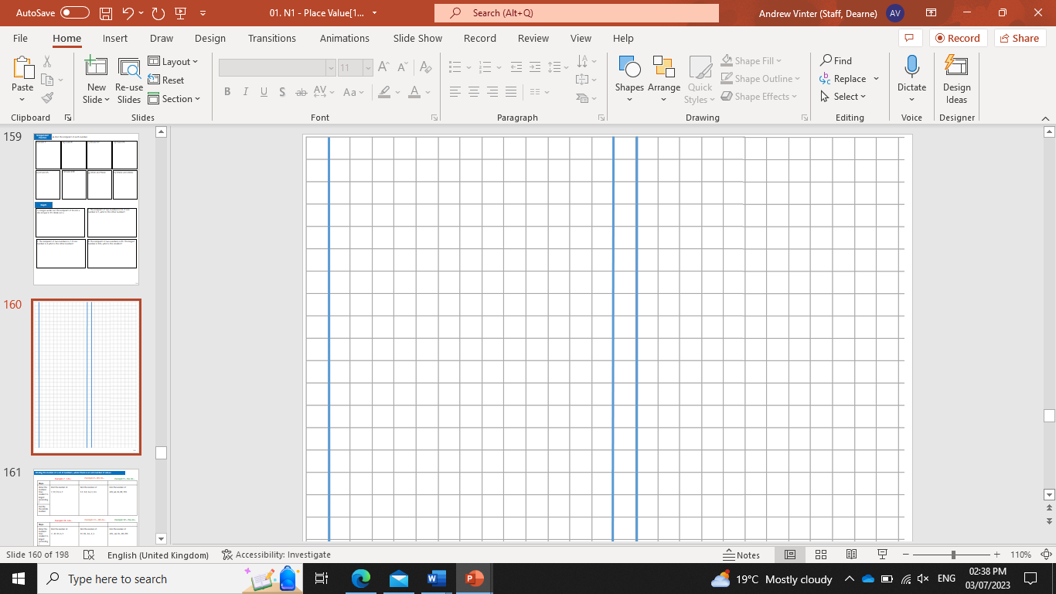
Setting out and adding integers up to four-digits using column method, no exchanging
Example 19 - I do…
Example 20 - We do…
Example 21 - You do…
Steps | Calculate 2623 + 325 | Calculate 1446 + 7203 | Calculate 341 + 4058
1. Line up both numbers in the correct columns
2. Add each column starting with the ones column
2948
8649
4399
Independent Practice
7. Add the following integers using column method
a) 2887 + 1100 b) 1350 + 1340 c) 2501 + 7233 d) 1703 + 240 e) 224 + 3420
3987
2690
9734
1943
3644
f) 4560 + 103 g) 137 + 2140 h) 2231 + 66 i) 54 + 2212 j) 1151 + 43
4663
2277
2266
2266
1194
k) What is the sum of 4056 and 223?
l) What is the sum of 2514 and 83?
4279
2597
m) Navid is adding up the numbers 32, 1340 and 210. He lines up all three numbers in place value columns. Look at his example and complete the following additions.
2410 + 5233 + 1152
312 + 1040 + 45
3 2 + 1 3 4 0
+ 2 1 0
1 5 8 2
8795
1397

Slide 7
Setting out and adding two- digit integers using column method involving exchanges
Example 22 - I do…
Example 23 - We do…
Example 24 - You do…
Steps
1. Line up numbers in the correct columns
2. Add each column starting with the ones
3. Write how many groups of ten are exchanged
4. Add this to your next column
Calculate 44 + 19
Calculate 16 + 55
Calculate 23 + 29
52
63
71
1. Add the following integers using column method
Independent Practice
8. Add the following integers using column method
a) 35 + 17 =
b) 25 + 16 =
c) 45 + 27 =
52
41
72
d) 25 + 15 =
e) 38 + 54 =
f) Find the sum of 47 and 17
40
92
64
g) 51 + 29 =
h) 37 + 46 =
i) 45 + 39 =
80
83
84

Slide 8

Tens
Ones
j) What calculation is represented
in the place value diagram?
k) Explain why you have not needed to do an exchange when adding these two numbers.
13
+
=
46
59
+
=
No column’s answer was higher than 9
Tens
Ones
l) What calculation is represented
in the place value diagram?
m) Explain why there are six counters in the tens column in the answer to this calculation.
15
+
=
47
62
+
=
10 ones were exchanged for 1 ten

Slide 9
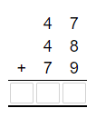
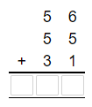
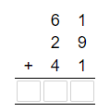
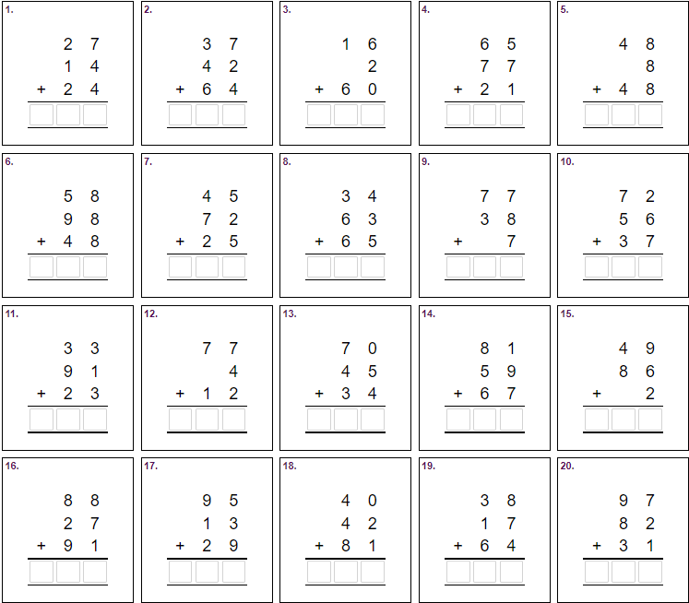
Adding multiple integers, up to two digits, using column method involving exchanges
Example 25 I do…
Example 26 - We do…
Example 27 - You do…
Steps | Calculate 47 + 48 + 79 | Calculate 56 + 55 + 31 | Calculate 61 + 29 + 41
1. Add each column starting with the ones column
2. Write how many groups of ten are exchanged
3. Include this when adding up the next column
1 7 4
1 4 2
1 3 1
Independent Practice
9. Add the following integers using column method
6 5
1 4 3
7 8
1 6 3
1 0 4
2 0 4
1 4 2
1 6 2
1 2 2
1 6 5
1 4 7
9 3
1 4 9
2 0 7
1 3 7
2 0 6
1 3 7
1 6 3
1 1 9
2 1 0

Slide 10
Setting out and adding multiple integers, up to two digits, using column method involving exchanges
Example 28 - I do…
Example 29 - We do…
Example 30 - You do…
Steps
1. Line up numbers in the correct columns
2. Add each column starting with the ones
3. Write how many groups of ten are exchanged
4. Add this to your next column and repeat
Calculate 29 + 17 + 9
Calculate 45 + 56 + 17
Calculate 42 + 52 + 38
Independent Practice
1. Add the following integers using column method
132
55
118
Independent Practice
10. Add the following integers using column method
a) 35 + 52 + 26 =
b) 25 + 16 + 98 =
c) 35 + 17 + 9 =
113
139
61
d) 25 + 66 + 15 =
e) 38 + 54 + 54=
f) Liam travels 49 miles, then 19 miles, then another 19 miles. How far does he travel?
106
146
87
g) 5, 6 and 7 are three consecutive numbers.
They add up to 18.
14, 15 and 16 are also three consecutive numbers. They add up to 45. Add up some other sets of three consecutive numbers and find their total. For example, 36, 37 and 38.
What do you notice about your answers? Use this space to write down your working out and your ideas.
36 + 37 + 38 = 111
25 + 26 + 27 = 78

Slide 11



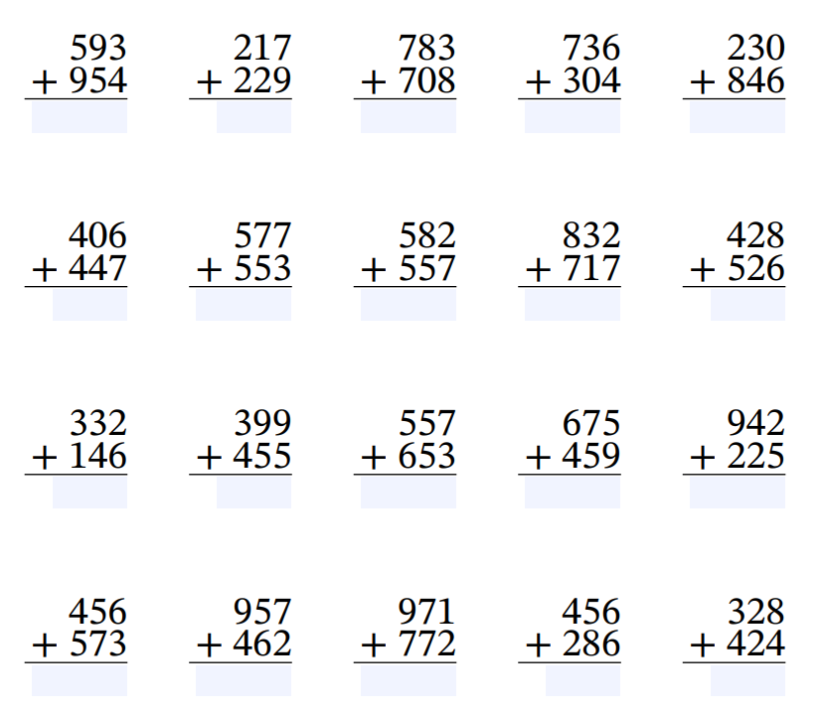
Adding two and three-digit integers using column method involving exchanges
Example 31 - I do…
Example 32 - We do…
Example 33 - You do…
Steps | Calculate 649 + 156 | Calculate 654 + 491 | Calculate 264 + 967
1. Add each column starting with the ones column
2. Write how many groups of ten are exchanged
3. Add this to your next column
705
1145
1231
Independent Practice
11. Add the following integers using column method
a) b) c) d) e)
1547
246
1491
1040
1076
f) g) h) i) j)
853
1130
1139
1549
554
k) l) m) n) o)
378
854
1210
1134
1167
p) q) r) s) t)
1029
1419
1743
342
752

Slide 12
Setting out and adding integers, up to three digits, using column method involving exchanges
Example 34 - I do…
Example 35 - We do…
Example 36 - You do…
Steps
1. Line up numbers in the correct columns
2. Add each column starting with the ones
3. Write how many groups of ten are exchanged
4. Add this to your next column and repeat
Calculate 248 + 67
Calculate 455 + 775
Calculate 425 + 878
1. Add the following integers using column method
1230
1330
315
Independent Practice
12. Add the following integers using column method
a) 352 + 451 =
b) 255 + 182 =
c) 458 + 379 =
803
437
837
d) 356 + 45 =
e) 259 + 67 =
f) 456 + 79 =
401
326
535
g) Find the sum of 796 and 455
h) Find the sum of 89 and 678
i) Find the sum of 49 and 887
1251
767
936

Slide 13

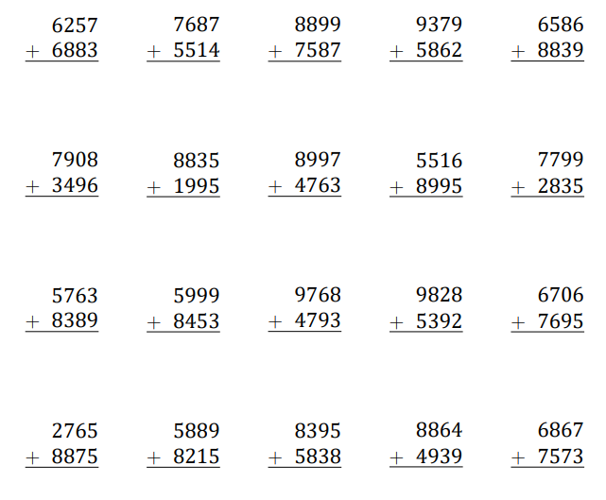
Adding integers, up to four digits, using column method involving exchanges
Example 37 - I do…
Example 38 - We do…
Example 39 - You do…
Steps | Calculate 9851 + 3279 | Calculate 5852 + 5378 | Calculate 8963 + 3267
1. Add each column starting with the ones column
2. Write how many groups of ten are exchanged
3. Add this to your next column
+
9 8 5 1
3 2 7 9
+
5 8 5 2
3 7 8
+
8 9 6 3
3 2 6 7
13130
6230
12230
Independent Practice
13. Add the following integers using column method
a) b) c) d) e)
13140
13201
16486
15241
15425
f) g) h) i) j)
8404
10830
13760
14511
3634
k) l) m) n) o)
14152
14452
4861
15220
6801
p) q) r) s) t)
9640
14104
8433
13803
14440

Slide 14
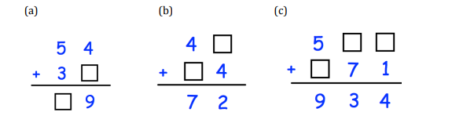
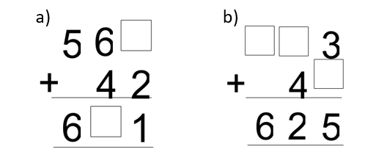

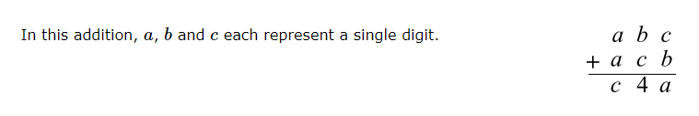

14. Work out the missing digits in each column addition
8
6
3
9
5
8
5
2
3
2
8
1
15.
In this column addition, the digits 0-9 each appear once. Complete the column addition by replacing each * with a digit.
16.
In this addition, a, b and c each represent a single digit.
What digits do a, b and c represent?
764
289
1053
3
6
7
17.
Thousands
Hundreds
Tens
Ones
a) What calculation is represented
in the place value diagram?
b) Represent the answer to the calculation on the diagram.
3496
+
=
4646
+
8142
=
18. Explain why it is easier to calculate 2222 + 4444 than 2222 + 9999.
In the first sum there is no exchanging

Slide 15
Skills Check
1. Calculate 72 + 21
93
2. Calculate 343 + 251
594
3. Calculate 103 + 9372
A: 10 402 B: 103 102 C: 9475 D: 10 375
4. Calculate 45 + 39
A: 84 B: 54 C: 74 D: 94
5. Calculate 63 + 18 + 21
A: 81 B: 102 C: 84 D: 92
4. Calculate 745 + 279
A: 914 B: 924 C: 1024 D: 1014
5. Calculate 8174 + 658
A: 8822 B: 8832 C: 8722 D: 8732

